Slide 1


Government Sri Krishnarajendra Silver Jubilee Technological Institute K. R. Circle, Bangalore - 560001
VISVESVARAYA TECHNOLOGICAL UNIVERSITY
BELAGAVI, KARNATAKA - 590018
Project Review on
“CHANNEL ESTIMATION ANALYSIS IN MIMO-OFDM WIRELESS COMMUNICATION”
By:
Chandan Kumar N S 1SK20EC008
Lakshmi H 1SK20EC023
Monika N S 1SK20EC026
Yogitha J 1SK20EC055
Under the guidance of
Dr. Nagesh R
HOD of ECE Department
Department of Electronics and Communication Engineering

Slide 2
PRESENTATION OVERVIEW
INTRODUCTION
LITERATURE SURVEY
OBJECTIVES
BLOCK DIAGRAM
METHODOLOGY
PROJECT PROGRESS
EXPECTED RESULT
REFERENCES

Slide 3
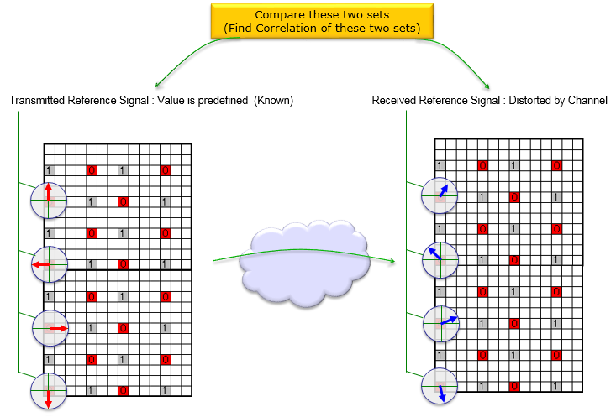
INTRODUCTION
Channel estimation is the process of estimating the channel characteristics between the transmit and receive antennas in a MIMO-OFDM system.

Slide 4
LITERATURE REVIEW
TITLE OF THE PAPER | AUTHOR AND YEAR OF THE PUBLICATION | OBSERVATION AND OUTCOMES
[1] CHANNEL ESTIMATION ANALYSIS IN MIMO-OFDM WIRELESS SYSTEMS | R. S. Ganesh, and J. Jayakumari, Akhila I.P in 2011 | Proposed a estimation method for a Rayleigh fading channel. From simulation they concluded that MMSE estimation has high quality performance than LS channel estimation.
[2] CHANNEL ESTIMATION TECHNIQUES IN MIMO-OFDM SYSTEMS – REVIEW ARTICLE | Raspinderjit Kaur Kahlon , Gurpreet Singh Walia , Anu Sheetal in 2015 | A review of different channel estimation techniques has been discussed. Different channel estimators have been discussed and it is concluded that pilot based channel estimation is far better than others.

Slide 5
TITLE OF THE PAPER | AUTHOR AND YEAR OF THE PUBLICATION | OBSERVATION AND OUTCOMES
[3] CASE STUDY ON CHANNEL ESTIMATION TECHNIQUES FOR MIMO-OFDM SYSTEMS | Mr. Srinivas Samala, Mr.T.Chandraprakash in 2018 | Diverse channel assessment process are reviewed and discussed.
[4] COMPARATIVE STUDY OF MIMO-OFDM CHANNEL ESTIMATION IN WIRELESS SYSTEMS | Obinna okoyeigbo, kennedy okokpujie, etinosa noma-osaghae, charles U. Ndujiuba, olamilekan shobayo, abolade jeremiah in 2018 | The block type pilot arrangements, comb type pilot arrangements, the LS and MMSE channel estimation technique using MISO and SISO, with and without OFDM, have been modelled, simulated and compared, and conclusions have been made.

Slide 6
OBJECTIVES
The objective of channel estimation is to estimate the time-varying channel between the transmitter and receiver in a wireless communication system.
To determine the accuracy of the channel estimation process and its impact on the performance of the system.
The channel estimation errors like attenuation, phase shift and noise can be reduced.

Slide 7
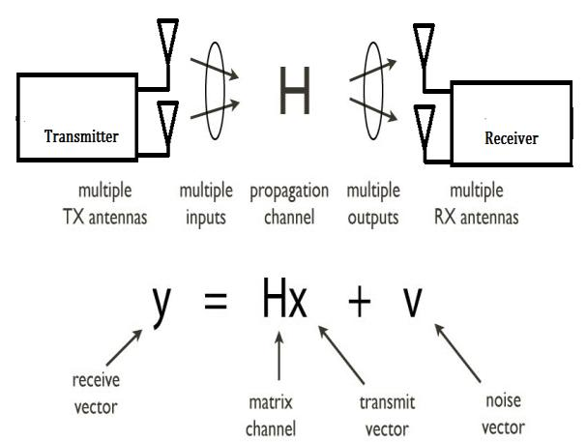
MIMO-Multiple Input Multiple Output
MIMO uses multiple antennas to send multiple parallel signals (from transmitter).
Multiple data streams transmitted in a single channel at the same time. Delivers simultaneous speed, coverage, and reliability improvements.
2x2 MIMO configuration

Slide 8
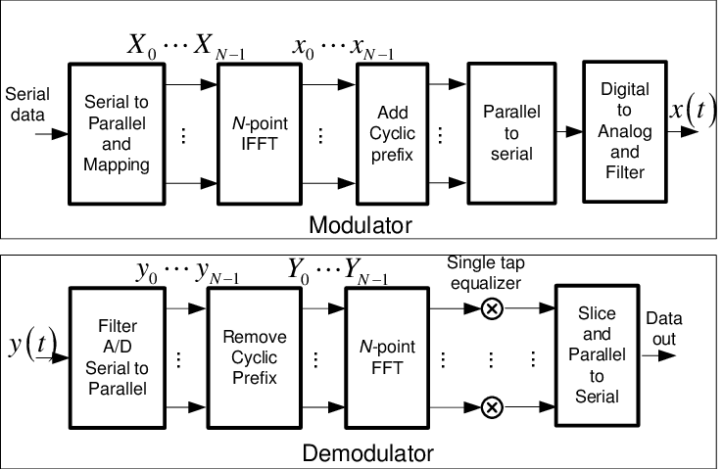
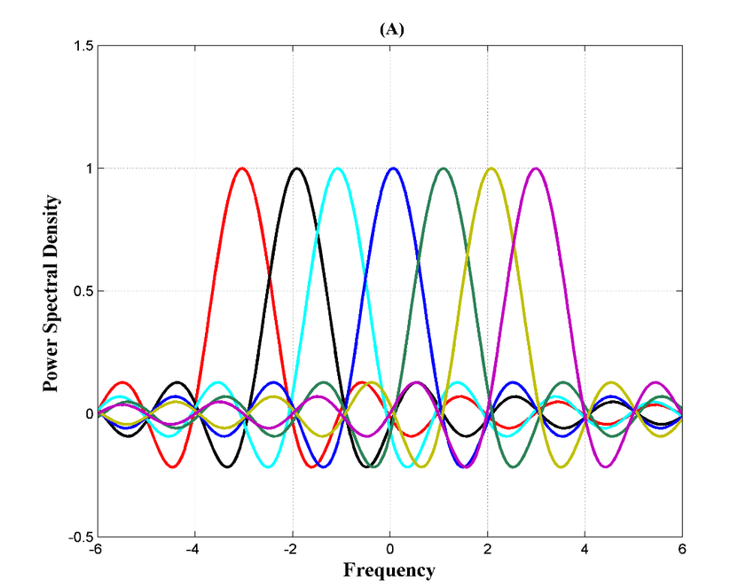
OFDM-Orthogonal frequency division multiplexing
The method for multiplexing signals which divides the available bandwidth into a series of frequencies known as tones.

Slide 9
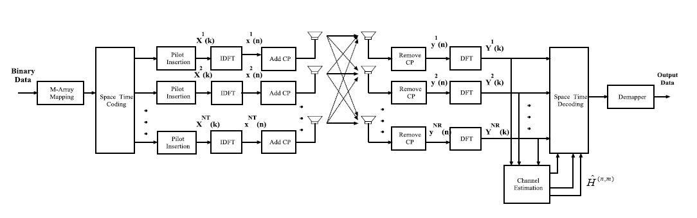
MIMO-OFDM

Slide 10
CHANNEL ESTIMATION TECHNIQUES
CHANNEL ESTIMATION
PILOT BASED CHANNEL ESTIMATION
SEMI BLIND CHANNEL ESTIMATION
BLIND CHANNEL ESTIMATION
LEAST- SQUARE,MINIMUM MEAN SQUARE ERROR
EXPECTATION- MAXIMIZATION ALGORITHM,LINEAR PREDICTION
BUSSANG ALGORITHM,SUBSPACED- BASED

Slide 11
METHODOLOGY
System model
Pilot transmission
Channel estimation techniques
Least squares (LS) estimation
Minimum mean squared error (MMSE)estimation
Pilot symbol reception
Channel estimation
Channel interpolation
Equalization
Performance evaluation
Optimization

Slide 12
PROJECT PROGRESS
Collected Research papers on this project.
Learning basic concepts on Channel estimation , MIMO , OFDM.
Exploring different MATLAB tools.
Implementing Channel Estimation on MATLAB.

Slide 13
EXPECTED RESULT
SNR : The signal to noise ratio (SNR) is the ratio of the signal power to noise power. The higher the value of SNR, the greater will be the quality of the received signal.
BER : The bit error rate (BER) of a transmission is the percentage of bits in the transmission that have errors as a result of noise, interference or other issues. The lesser the value of bit error error rate , greater will be the quality of the received signal.
CHANNEL CAPACITY : It is the maximum rate at which information can be transmitted through a channel.

Slide 14
REFERENCES
[1] channel estimation analysis in MIMO-OFDM wireless systems R. S. Ganesh, and J. Jayakumari, Akhila i.P in 2011
[2] channel estimation techniques in MIMO-OFDM systems – review article raspinderjit kaur kahlon , gurpreet singh walia , anu sheetal in 2015
[3] case study on channel estimation techniques for MIMO-OFDM systems Mr. srinivas samala, Mr.t.chandraprakash in 2018
[4] comparative study of MIMO-OFDM channel estimation in wireless systems Obinna okoyeigbo, Kennedy okokpujie, Etinosa noma-osaghae, Charles u. Ndujiuba, Olamilekan shobayo, Abolade jeremiah in 2018

Slide 15

Thank you

